Slide 1
Provenance Visualization on the Web
Web-Probe
Hugo D. Porras
Committee Members:
Dr. Paulo Pinheiro da Silva
Dr. Natalia Villanueva Rosales
Dr. Deana Pennington

Slide 2
Overview
Project Description
Background Information
Related Work
Motivation
Purpose
Approach
Challenges
Software Requirements
Design
Implementation
Validation and Verification
Future Work

Slide 3
Background Information
Provenance
Meta-information about the final results and how they were generated
Includes:
Provenance meta-information
a description of the origin of a piece of knowledge
Process meta-information
a description of the reasoning process used to generate an answer
Intermediate/partial results

Slide 4
Background Information
Proof Markup Language (PML)
Provenance encoded in XML-RDF
Distributed collection of XML documents
Uniquely identified by URIs
Described in 3 OWL Ontologies
PML-P, PML-J, and PML-T
Java API
Provenance Visualization
Visualization is a technique used to facilitate the understanding of scientific results
Improve the presentation of provenance using graphs
Goal: a framework suitable for visualizing both complex results and their associated provenance

Slide 5
Related Work
IW-Browser
Graphical rendering tool for PML proofs.
Developed by Inference Web
Probe-It
Java-based PML Provenance Visualization browser
Greater focus on scientific visualizations
Visualization Knowledge (VisKo) project
Framework for query generated visualizations
Provides visualizations tied to intermediate results of provenance traces.

Slide 6
Project Motivation
Probe-It need for Improvements
Lacked quick accessibility on the Web
Local Installation Execution
Required Installation of Java Runtime Environment
Security permission requests
Long loading times for Provenance Traces
Use of Local Resources
New web technologies
Data Driven Documents (D3.js)
More interactive designs

Slide 7
Purpose and Scope
New web-application: Web-Probe
Provenance Visualization support
No Installation
Fully hosted on the web
Could be used through any major web-browser with Java-Script capabilities
Faster Loading Times

Slide 8
Overview
Project Description
Background Information
Related Work
Motivation
Purpose
Approach
Challenges
Software Requirements
Design
Implementation
Validation and Verification
Future Work

Slide 9
Challenges
Java-Script to Java communication
Java PML API
Solution: DWR (Direct Web Remoting)
Ajax and XML
Creating the User Interface
Visually displaying provenance graphs
Interactive renderings
Solution: D3.js (Data-Driven Documents)
External Connections
Visualization Cache
VisKo
RDF-Store Services

Slide 10
Prototype
Proof of concept
Communication to Java
PML API
Visualization Cache
VisKo
RDF-Store Services
User Interface
D3.js

Slide 11
Software Requirements
Goal: Replicate Probe-It functionality on the Web
Web-Probe
Query View
Product View
Local Justification View
Global Justification View
Extra Features
No additional Installation (besides web-browser)
Use Pre-rendered Visualizations
(Visualization Cache System)
Faster Loading Times
Application Startup Times
Proof Loading Times

Slide 12
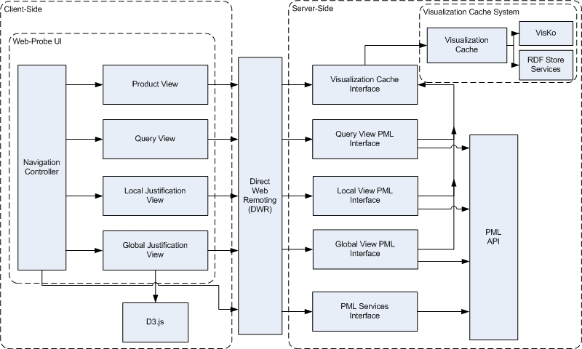
Software Design - Overlaying Architecture

Slide 13
Implementation
Client-Side
HTML, CSS, Java-Script (Jquery, D3.js), JSON.
Follow designed Architecture
DWR Connection
Generates Java-Script Interfaces
XML documented Java Interfaces
Server-Side
Object Oriented Java
Client-Side Interfaces
Convert Java Objects to JSON representation
Visualization Cache System

Slide 14
Setup and Code Repository
Setup
IW server at UTEP Cyber-ShARE Center.
http://iw.cs.utep.edu/Web-Probe/
Tomcat 7 – Java Servlet
Manages Web-applications
Easy deployment with projects packaged in WAR files.
Web-Probe can be setup on other servers
Instructions online: https://github.com/hdporras/Web-Probe/wiki/Installing-Web-Probe
GitHub Repository
GIT
https://github.com/hdporras/Web-Probe.git
https://github.com/hdporras/Web-Probe

Slide 15
Validation and Verification
Approach
Ensure that all the core functionality that was provided by Probe-It was replicated in Web-Probe
Feature | Probe-It | Web-Probe
Query View | √ | √
Product View | √ | √
Local Justification View | √ | √
Global Justification View | √ | √
Visualization Cache Connection | √ | √
Accessible using only a Java-Script enabled Web Browser |  | √

Slide 16
Start-Time Comparison

Slide 17
Proof Load Times
Test Load Times of 2 proofs
Hole’s Code
Scientific Publication
Test on 2 machines in Cyber-ShARE
Work Station
NetBook
Test on machine off location
Home Personal Computer

Slide 18
Load Times – Work Station Proof 1

Slide 19
Load Times – Work Station Proof 2

Slide 20
Load Times – NetBook Proof 1

Slide 21
Load Times – NetBook Proof 2

Slide 22
Load Times – Home PC Proof 1

Slide 23
Load Times – Home PC Proof 2

Slide 24
Overview
Project Description
Background Information
Related Work
Motivation
Purpose
Approach
Challenges
Software Requirements
Design
Implementation
Validation and Verification
Future Work

Slide 25
Summary
Web-application version of Probe-It now on the Web
Created a Web-application that has improved the experience of Provenance Visualization on the Web
Potential for more improvement
Future Work
PROV-O Support
New Provenance Recommendation from W3C
Create new forms of Provenance Visualizations using D3.js

Slide 26
Semester Work
PROV-O support for Cyber-ShARE Provenance Applications
WDO-IT
Data-Annotator
Deriva
Web-Probe
VisKo

Slide 27
Semester Plan
January
Understand Differences between PROV-O and PML
February
Generate a mapping of PROV-O to PML
Understand other Cyber-ShARE applications and their use of PML
March
Design a solution to add PROV-O support for necessary applications
Implementation of solution
April
Testing of solution
Documentation of solution

Slide 28
Acknowledgements
This work used resources from Cyber-ShARE Center of Excellence, which is supported by National Science Foundation grant number HRD-0734825.

Slide 29

Questions

